Slide 1
Coronavirus!
Calls are Carol Christ’s…
She has made the call: classes are now moved online: I am still busy adding audio to slide files…
Plus zoom sessions
Plus bCourse discussion threads (mandatory)
Plus zoom & email office hours…
What is the state of the epidemic?
I am looking at the sources on: <https://www.bradford-delong.com/2020/03/coronavirus-daily-read-list.html>
What else should I be looking at?

Slide 2

MOAR Coronavirus!
It’s a Thing for Geezers!
Mortality for the Youngs very low…
It’s the flu for them…

Slide 3
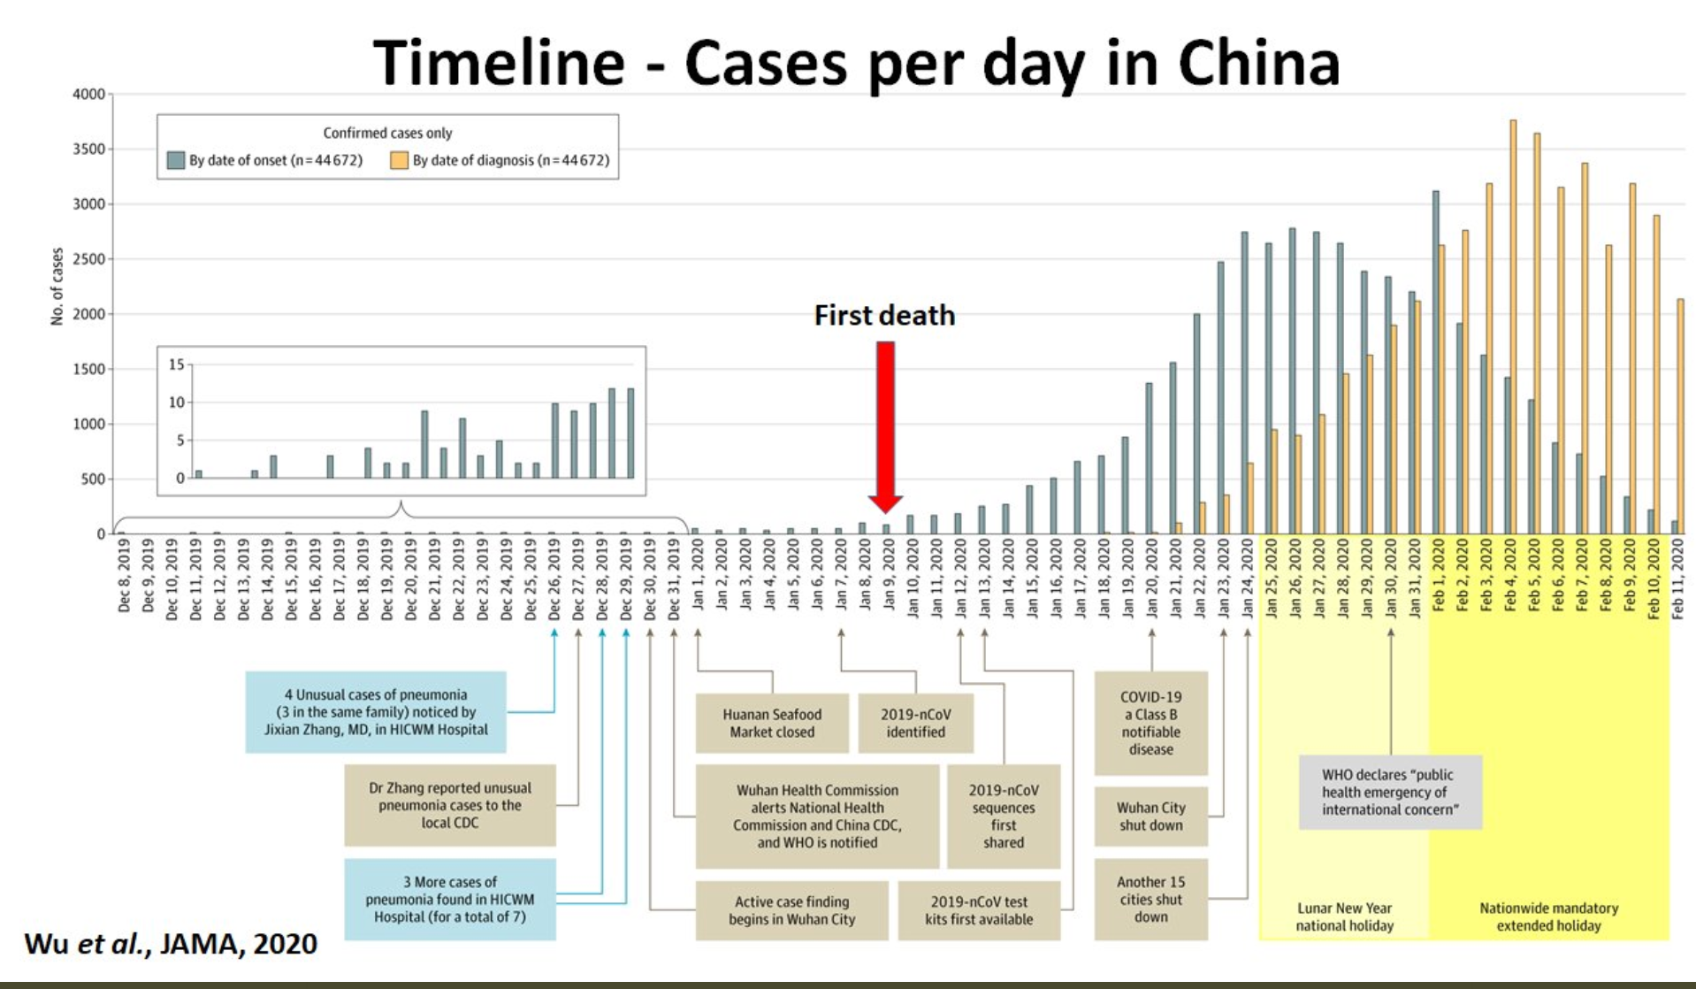
MOAR Coronavirus! II
China Beat It!
Shut down Wuhan when 200 cases per day
That seems to have been a good decision

Slide 4

MOAR Coronavirus! III
When Is It Appropriate to Move on This?
Immediate social distancing…
Self-isolate if you have a cough and a fever…
Hope that warmer temperatures will do to this what they did to SARS…
Otherwise, when do you want to start spreading out transmission. It seems that early is as good as later…

Slide 5
About the Course
The long 20th century will in all likelihood be seen in the future as the watershed in human experience:
Nine aspects:
History was primarily economic—and that was true for the first time…
Explosion of wealth: 2%+ per year…
Cornucopia of technology…
Demographic transition…
Feminist revolution…
Empowered tyrannies…
Wealth gulfs…
Inclusion and hierarchy attenuation…
Mismanagement and insecurity…
The global public health system and global epidemic transmission
Humanity is unlikely to see as transformative—for good and ill, but mostly for good, so far at least, I think—a century again…

Slide 6
U.C. Berkeley: Economics 115: Spring 2020
20th Century Economic History: Lecture 13: Social Democracy: High Tide and Ebb
Brad DeLong
Department of Economics & Blum Center, U.C. Berkeley; & WCEG
delong@econ.berkeley.edu
last revised: 2020-03-24
for delivery: ???
<https://bcourses.berkeley.edu/courses/1487684>
<https://github.com/braddelong/public-files/blob/master/econ-115-lecture-13.pptx>

Slide 7
Takeaways from Last Time
From Thirty Glorious Years
Come up with your own five takeaways from our look at the “Thirty Glorious Years”…

Slide 8
Preview
Social Democracy: High Tide and Ebb
Takeaways from Last Time
Preview
Administration
Social Democracy: Successes at Regulation and Provision
Validating Rights Other than Property Rights
Moochers and Takers: Trouble for the Future
Social Democratic Political Stabilization
Review: ??
Failures of Social Democracy
Driving for Full Employment
The Inflation of the 1970s
Oil Shocks
Why Did It Matter
Takeaways

Slide 9
Econ 115: Administration: Office Hours &c.
DeLong: Office Hours
Email <delong@econ.berkeley.edu> for a virtual appointment
Read: DeLong, chapter 18
Slides: <https://github.com/braddelong/public-files/blob/master/econ-115-lecture-13.pptx>
Do: Assignments ????…
Memo: bCourses website <https://bcourses.berkeley.edu/courses/1487684>

Slide 10

Social Democracy: High Tide and Ebb
Successes of social democracy:
The 1891 Erfurt program of the German socialists
The ‘reform” part:
universal adult (including female) suffrage,
the separation of church and state,
the secularization of education,
the eight-hour day,
government regulation of health and safety in the workplace,
the right to unionize,
unemployment insurance paid by the state and administered by the workers,
popular referenda to control parliaments and bureaucracies,
& the election of judges
Cf.: U.S. social democracy today…
2:00
Notes:
In 1891, meeting in Erfurt, the German socialists set out their program. It had two parts—a reform part and a revolutionary part. Aside from some peculiarly German causes (like wresting control of foreign policy away from the Emperor, the Junkers, and the army), the reform part called for: universal adult (including female) suffrage, the separation of church and state, the secularization of education, the eight-hour day, government regulation of health and safety in the workplace, the right to unionize, unemployment insurance paid by the state and administered by the workers, popular referenda to control parliaments and bureaucracies, and the election of judges.
In the United States today, social democracy includes the interstate highway system, airport construction, air traffic control, the Coast Guard, the National Parks, government support for direct research and development through agencies like the National Institute of Standards and Technology, the National Oceanic and Atmospheric Administration, and the National Institutes of Health. It includes the antitrust lawyers of the Department of Justice and the Federal Trade Commission, the financial regulators in the Securities and Exchange Commission, the Office of the Comptroller of the Currency, the Federal Reserve, and the Pension Benefit Guarantee Corporation. It includes the promise by the federal government to insure small bank depositors against bank failures, and big bankers—systemically important financial institutions—against collapse. It includes Social Security and all of its means-tested and non-means-tested cousins—Supplemental Security Income, Food Stamps, Head Start, and the Earned Income Tax Credit. None of these programs would be seen as a proper use of the government by even the weakest-tea sympathizer with libertarianism. None of them fit under the definition of the “night watchman” state. And America’s version of social democracy is distinctly anemic relative to those found elsewhere in the Global North.

Slide 11
Social Democracy Politically Successful
Politicians who want to cut back these programs have to hide their desires:
Voters distrust politicians who seek to cut back on the major programs of the social insurance state
Voters find taxes earmarked to support social insurance programs less distasteful than taxes that flow into general revenues.
Rght-of-center parties made no attempt to make a stand against social democracy.
In the middle of World War II Britain’s conservative Prime Minister, Winston Churchill, could call for the postwar:
abolition of unemployment
compulsory public insurance “for all purposes for the cradle to the grave”
historian Donald Sassoon: “standing up boldly against the welfare state… would have taken either some guts and/or a strong urge to court unpopularity. The Conservative Party was too wise to have either.”
U.S. somewhat of an outlier
In their heyday, social democracy was part of an extraordinarily successful institutional configuration
1:30
Notes:
These government programs and their analogues in other advanced industrial countries have been remarkably politically successful: Voters distrust politicians who seek to cut back on the major programs of the social insurance state. Voters find taxes earmarked to support social insurance programs less distasteful than taxes that flow into general revenues. Outside of the United States, right-of-center parties made no attempt to make a stand against social democracy. In the middle of World War II Britain’s conservative Prime Minister, Winston Churchill, could call for the postwar abolition of unemployment, and compulsory public insurance “for all purposes deom the cradle to the grave.” Historian Donald Sassoon commented, “standing up boldly against the welfare state… would have taken either some guts and/or a strong urge to court unpopularity. The Conservative Party was too wise to have either.”
And we have already seen American president Dwight D. Eisenhower’s dismissal of those who want to dismantle the social insurance state as “stupid”
And in their heyday of the thirty glorious years, they were part of an economically successful institutional configuration: growth was faster than ever before, unemployment was low, incomes were not too unequally distributed—at least if you were a native-born white guy—the business cycle was very moderate in historical perspective, and inflation was not seen as a huge problem, for even though prices were rising wages were rising by more.

Slide 12
Validating Rights Other than Property Rights
The late 1800s socialist program also had a revolutionary component:
Reformism, however, was very attractive: it delivered the goods
Socialists in the industrial core became weak-tea socialists
And then transformed themselves into social democrats
The example of really-existing socialism
Behind the Iron Curtain, communists became social democrats as well
The dream: remove goods and services—and status—from the domain of market allocation, where the only rights you had that mattered were your property rights.
1:30
Notes:
Of course, the socialist program of the nineteenth century also had a revolutionary component. But in the process of accomplishing its reformist program, weak-tea socialists in the industrial core of the world economy transformed into social democrats. And in the process of watching their central-planned economies run according to the precepts of really-existing socialism fall behind, strong-tea communists behind the Iron Curtain became social democrats as well. The revolutionary part of the program was given up as impossible to implement.
But it was possible to have the government provide in important aspects of your life, so that “we cannot afford it” became a thing of restricted power and reach. The point was not so much for the government to provide a “safety net”, or an equality of minimum needs. The point was to create what British post-WWII Prime Minister Clement Attlee hoped would be an “equality of the highest standards”: to continually extend the sphere in which you were treated well even if you did not have the social power in the form of wealth and cash.

Slide 13
Shrinking Income Differences
But where the rubber met the road the emphasis was different:
Not so much removing commodities from the market
But providing all with incomes with which to purchase
Fears that public provision would be inefficient in many ways
Success of Keynesian doctrines
Let the voters decide how large social democracy would grow
The “leaky bucket” of Art Okun
4:15
Notes:
But, where the rubber met the road, it turned out that much of social democracy focused not on removing commodities from the market, but rather on providing income supports and progressive taxes to redistribute income in a more egalitarian direction.
Why bother with public provision—often inefficient—when with an egalitarian distribution of income those who wanted goods and services could simply buy them? This would avoid the waste of provision to those who did not want. And it would harness the magical efficiencies of the market to societal goals. Redistribution and then dollar votes in the market place rather than public provision seemed the smart road to social democracy.
The growth of Keynesian doctrines of macroeconomic management as a result of the Great Depression meant that the government role in the economy was going to expand. The government was to spend a fortune to stimulate the economy and avoid depression, then it should at least spend this fortune efficiently, and in a way that enhanced the general welfare. On this strong role for social insurance nearly all could agree.
Centrists feared that abandonment of social insurance would lead to abandonment of the Keynesian stabilization mission, and a return of the Great Depression.
Left-wingers and unions saw in an expanded role of the government a way to eliminate, or at least to reduce, the evils of laissez-faire.
Right-wingers and industrialists hoped that the “cooperative” social and production climate could be continued, and saw the social insurance state as offering the possibility of doing so at a low price in terms of taxes levied to finance the programs.
Under social democracy, people choose at that ballot box how much income and wealth inequality they wanted to see. They could vote for more or less progressive taxes. They could expand and contract the set of public and semi-public goods and of benefits offered to all citizens. And they could expand and contract the set of means-tested benefits offered to the poor.
The standard way of thinking technocratically about how a social democracy should manage its income distribution became Arthur Okun’s proposed metaphor of the “leaky bucket.” After a while, increases in redistribution from rich to poor might begin to create incentive problems that would reduce the benefit to the poor from a policy that would cut the income of the rich. How leaky could the bucket get before redistribution had reached an optimal level?
Socialists tended to argue that any leakage up to 100% was acceptable: anything that made the poor better-off was worth doing, and perhaps some things that made both poor and rich worse-off were worth doing, because excessive wealth was a scandal.
Conservatives argued that any leakage at all was unacceptable: the point ought to be to maximize the size of the pie, rather than to redistribute income. (True conservatives argued that the question was illegitimate: public policy had no business trying to shift the distribution of income at all.)
Social democrats took the middle ground: redistribution was fine—was a good thing, because ex-ante behind a veil of ignorance all citizens would have wanted to be insured against the risk of poverty—but incentives for maximizing production were fine too. How leaky the bucket could be allowed to get was a matter of judgement and politics: social democracy should strive for programs that were buckets with small leaks and avoid programs that corresponded to buckets with large leaks. And all the while they should aim at the utilitarian greatest good of the greatest number.

Slide 14
Moochers and Takers
The Polanyian Perplex Problem:
Humans as gift exchange animals
Not good to always be a giver or a receiver
Not good for others to always be givers…
Especially not good for others to always be receivers…
Contested societal definition of what it is to be a “moocher”
The logic of social democracy
But if citizens believe some are more equal—and worthy—than others?
These issues could be papered over, as long as economic growth remained strong, and egalitarian
3:00
Notes:
But there was a problem.
Humans see their society as a network of reciprocal gift-exchange relationships. We are all interdependent, and we all do much better if we do things for one another rather than requiring that everyone do everything for him or herself. In these relationships, we do not always want to be the receiver: it makes us feel small and inadequate. In these relationships, we do not always want to be the giver: that makes us feel exploited and grifted. And we altruistically disapprove whenever we see a situation in which somebody else seems to be following a life-strategy of always trying to be the receiver.
Moreover, what it means to be a “giver” or a “receiver” is contested. When the moneylender agrees to forgive part of the interest you owe and add it in to the principal and so put you deeper in debt, has he done you a favor in not exacting his contractual full pound of flesh, or has he cheated you by having originally exercised his bargaining power to the full to set the interest rate so unreasonably and unconscionably high? When the local Frankish warrior who has just moved in to the Roman Empire allows you to become his serf—to work for him for three days a week in return for his “protection” against other Frankish warriors who have just moved in—are you a receiver of a boon from this particular Frankish warrior, or have the Franks as a tribe and as a nascent feudal aristocratic class stolen half of your labor time from you? Are mothers raising children without a partner our benefactors, as they are performing the hard and incredibly valuable work of raising the next generation whose Social Security taxes will fund our Social Security checks? Or are they “welfare queens”, popping out children because then lazing about, probably buying fried chicken, watermelon, and drugs with the AFDC welfare check, is an easier life than getting and holding a job?
The logic of social democracy is that we are all equals as citizens, and equals should not be treated unequally without very good cause—and, in a market economy, the good cause is that we want to incentivize economic growth by rewarding skill, industry, and foresight, and doing so inevitably involves a good deal of the rewarding of good luck as well. But what if some citizens think that they are more equal than others—the others who, for one reason or another, are not full members of an ethno-national community? And what of those who, in the case of means-tested programs, seem to be always receiving not because they have bad luck but simply because they never contribute?
These issues, too, could be papered over as long as employment stayed high and growth stayed strong.

Slide 15
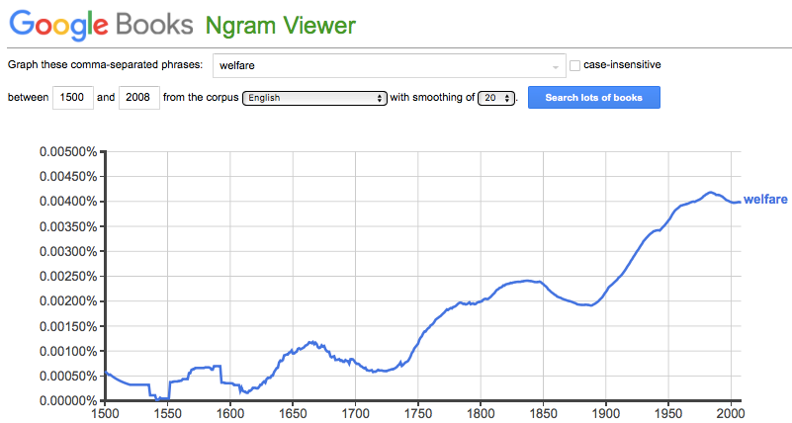
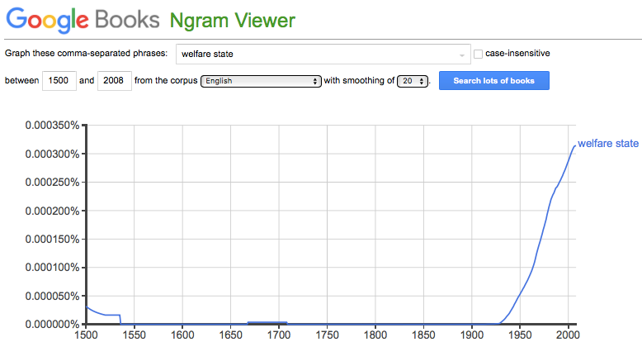
The Welfare State
Origins of the term “welfare state”:
“Fare well…”
“Fare”—a traveling, a journey, by extension one’s journey through life
“Well”—easily, abundantly
Hence “welfare”—the well-being of a group
Hence “welfare capitalism”—Edward Filene
Hence “welfare state”
1:30
Notes:
We can see how these problems sharpened themselves in the age of social democracy by looking at the linguistic evolution of the term "welfare state". The term welfare state comes from the word state, that is the government, and from the word welfare. We hear the word welfare in the greeting: farewell. That is, fare, a traveling, a Journey, by extension one journeys through life. Plus, well, that is, easily and abundantly and happily. A "welfare state" is a government that assists in making your journey through life abundant and happy. Who could find that objectionable?
“Welfare” thus become the well-being of a group.
And when American plutocrat, philanthropist, and political activist Edward Filene in the 1920s searches for a term that would have strongly positive associations for his proposed plan to avoid socialism by having the large corporations that people work for provide the populace with pensions, health coverage, and other benefits, he chooses the term “welfare capitalism”. And it is his political opponents in the 1920s and 1930s who try to capitalize on those same positive associations by saying: "no, not welfare capitalism – but welfare state”.

Slide 16
But Then Why Did People Come to Hate the Term “Welfare State”?
David Garland: The Welfare State: A Very Short Introduction:
Garland finds himself spelled to say:
“The welfare state’s name has always been a problem… entered common usage in the 1950s and 1960s… least popular with the people most closely associated with the institutions it purported to describe. William Beveridge… heartily disliked the term. He objected that it implied a ‘something for nothing’, ‘Santa Claus state’ quite at odds with his stress on the importance of worker contributions, voluntary effort, and personal responsibility. T. H. Marshall…Richard Titmuss…
And:
“‘The welfare state’… a hostile phrase, used by social policy’s enemies rather than its friends… a mendicant clientele receiving undeserved benefits from an overbearing state. That the name eventually became established, and used by supporter and opponent alike, has meant that these negative associations remain just beneath the surface and are all-too-easily brought to mind…”
Something weird has happened linguistically between Edward Filene’s 1920s and David Garland’s 2010s.
1:00
Notes:
But then how is it that David Garland, in his recent book The Welfare State: A Very Short Introduction, finds himself impelled to say:
>The welfare state’s name has always been a problem… entered common usage in the 1950s and 1960s… least popular with the people most closely associated with the institutions it purported to describe. William Beveridge… heartily disliked the term. He objected that it implied a ‘something for nothing’, ‘Santa Claus state’ quite at odds with his stress on the importance of worker contributions, voluntary effort, and personal responsibility. T. H. Marshall…Richard Titmuss….
And:
>‘The welfare state’… a hostile phrase, used by social policy’s enemies rather than its friends… a mendicant clientele receiving undeserved benefits from an overbearing state. That the name eventually became established, and used by supporter and opponent alike, has meant that these negative associations remain just beneath the surface and are all-too-easily brought to mind…”
Something weird has happened linguistically between Edward Filene’s 1920s and David Garland’s 2010s.

Slide 17
The Polanyian Perplex
This is, once again, the root of the phenomenon:
People believe that in a good society they have:
Gift-exchange relationships with other members:
In which they are not suckers
And are not grifters
Rights to:
Keep their community stable
Have their income not collapse as long as they “work hard”
Keep the kind of job they expected—often at the same firm
A market economy is not guaranteed to produce (1), (2), and (3)—have property rights and thus control over things, plus the ability to use your property rights to make things that rich people have a serious jones for
But the moment you start using the government to provide social insurance you set in motion enormous tension
1:30
Notes:
The Polanyian Perplex that we have seen before is once again at the root of the phenomenon. People believe that in a good society they have gift exchange relationships with other members in which they are not suckers and are not grifters. If you have a situation in which people conceptualize themselves as being always suckers or always grifters, people will object. People will seek a different way of understanding society, a way that allows them not to think of it in this way.
And people may seek a different society.
Remember, Polanyi’s fundamental insight: that people believe they have a right to (1) keep their communities stable, (2) keep their incomes in accord with what they expect as long as they work hard, and (3) keep the kind of job they expect—and often at the same firm. A market economy is not guaranteed to produce 1, 2, or 3. A market economy is designed to reward property rights and control over things—plus give you the ability to use your property rights to make things that rich people have a serious Jones for, and thus acquire social power.
But the moment you start using the government to provide social insurance in a redistribution or rather than a gift exchange context you set in motion enormous tensions.

Slide 18
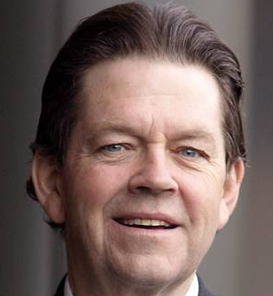
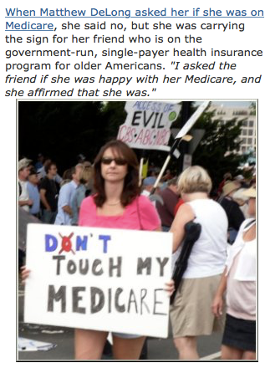
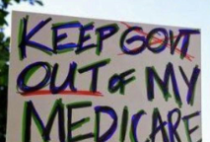
Strongly Dissonant Cognition
American Right-Wing Thought:
2009: Arthur Laffer:
“If you like the post office and the Department of Motor Vehicles and you think they’re run well, just wait till you see Medicare, Medicaid and health care done by the government…”
1993: John Breaux:
“…was walking through the New Orleans airport, returning home, when an elderly female constituent approached him. ‘Senator, Senator’, she said, plucking emotionally at his sleeve. ‘Now don't you let the government get a hold of my Medicare’. Breaux, ever the charmer, smiled and said reassuringly of this greatest of government entitlement programs, ‘Oh, no, we won't let the government touch your Medicare’…
The joke, of course was on them—or was it on us?
2:15
Notes:
We can see these enormous tensions in the strongly dissonant cognition of American right-wing thought.
In my tickler file I have a quote from right-wing hack Arthur Laffer during the 2009 ObamaCare debate:
>“If you like the post office and the Department of Motor Vehicles and you think they’re run well, just wait till you see Medicare, Medicaid and health care done by the government…”
I have a quote from 1993 from Louisiana Senator John Breaux. He:
>…was walking through the New Orleans airport, returning home, when an elderly female constituent approached him. ‘Senator, Senator’, she said, plucking emotionally at his sleeve. ‘Now don't you let the government get a hold of my Medicare’. Breaux, ever the charmer, smiled and said reassuringly of this greatest of government entitlement programs, ‘Oh, no, we won't let the government touch your Medicare’…
The joke, of course was on them—or was it on us? Breaux did not support the 1993 attempt to reform America’s dysfunctional health care financing system, but instead ran for the hills—thus contributing to enormous social costs by which we in America today spend three times as much on health care as our peer nations for worse results. Arthur Laffer has become fat and happy—and is still quoted with a straight face by many journalists who know better, and admit to me in private that they know better—pushing for increased income and wealth inequality at the price of slower overall economic growth and reduced societal economic well-being

Slide 19
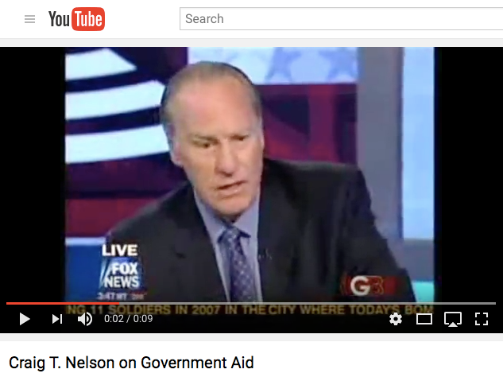
Would a System That Steps Back from Social Democracy Go Smash?
NELSON: We are a republic. And that means that we need to be represented. We're not being represented. I'm not going to pay any more money…
BECK: You're seriously saying you won't pay income tax anymore?
NELSON: I'm really thinking about it, Glenn…. There are programs that they're asking me to fund that I refuse to fund…. I'm not going to spend money on these things that you're asking me to. They should be allowed to go bankrupt!… I've been on food stamps and welfare. Anybody help me out? No. No…. [What] gave me hope… gave me encouragement, and… gave me a vision… [was] my education….
Of course, stepping back from social democracy will produce a society that also has enormous tensions—and great poverty:
David Garland on the “indispensability” of the welfare state:
The welfare state—social insurance—is indispensable
Why? Because capitalist economies are prone to rapid undirected and unwanted changes…
Plus uncertainty, insecurity, inequality…
All established orders and expectations are steamed away…
But capitalism needs a supportive social environment
The welfare state uses the magic of averages and the collectivization of risk to render market capitalism
habitable for humans
compatible with modern democracy
2:30
Notes:
Of course, a system that tries to step back from the redistributive equalization of the welfare state would also create enormous tensions, and go smash.
For one thing, it would produce great poverty and great anxiety. As David Garland writes, the welfare state is “indispensable”. Why? Because capitalist economies are prone to rapid undirected and unwanted changes. These produce not just poverty for those who are unlucky or creatively destroyed by changing technology, sociology, and business organization. These also prdouce uncertainty, insecurity, inequality as, as Karl Marx and Friedrich Engels put it in 1848, the onward march of capitalism means that all established orders and expectations are steamed away.
And yet capitalism needs those established orders and expectations, for capitalism needs a supportive social environment
The welfare state uses the magic of averages and the collectivization of risk to render market capitalism 1. habitable for real humans, and 2. compatible with modern democracy.
Yet people are so uneasy about departing from thinking of themselves as equal partners in a network of reciprocal gift exchange that they cannot see their situation at all. Witness Craig Nelson’s hatred of the welfare state, and his desire not to pay taxes to support it:
>NELSON: We are a republic. And that means that we need to be represented. We're not being represented. I'm not going to pay any more money…
>BECK: You're seriously saying you won't pay income tax anymore?
>NELSON: I'm really thinking about it, Glenn…. There are programs that they're asking me to fund that I refuse to fund…. I'm not going to spend money on these things that you're asking me to. They should be allowed to go bankrupt!… I've been on food stamps and welfare. Anybody help me out? No. No…. [What] gave me hope… gave me encouragement, and… gave me a vision… [was] my education….
Not just food stamps and welfare, but his education were largely paid for by Big Government.
The joke is on him, yes?
But, rather, since now he is flush, and since the stability of the system requires people accurately seeing what is going on, the joke is on us.

Slide 20
Would a System That Steps Back from Social Democracy Go Smash?
NELSON: We are a republic. And that means that we need to be represented. We're not being represented. I'm not going to pay any more money…
BECK: You're seriously saying you won't pay income tax anymore?
NELSON: I'm really thinking about it, Glenn…. There are programs that they're asking me to fund that I refuse to fund…. I'm not going to spend money on these things that you're asking me to. They should be allowed to go bankrupt!… I've been on food stamps and welfare. Anybody help me out? No. No…. [What] gave me hope… gave me encouragement, and… gave me a vision… [was] my education….
Of course, stepping back from social democracy will produce a society that also has enormous tensions—and great poverty:
David Garland on the “indispensability” of the welfare state:
The welfare state—social insurance—is indispensable
Why? Because capitalist economies are prone to rapid undirected and unwanted changes…
Plus uncertainty, insecurity, inequality…
All established orders and expectations are steamed away…
But capitalism needs a supportive social environment
The welfare state uses the magic of averages and the collectivization of risk to render market capitalism
habitable for humans
compatible with modern democracy
2:30
Notes:
Of course, a system that tries to step back from the redistributive equalization of the welfare state would also create enormous tensions, and go smash.
For one thing, it would produce great poverty and great anxiety. As David Garland writes, the welfare state is “indispensable”. Why? Because capitalist economies are prone to rapid undirected and unwanted changes. These produce not just poverty for those who are unlucky or creatively destroyed by changing technology, sociology, and business organization. These also prdouce uncertainty, insecurity, inequality as, as Karl Marx and Friedrich Engels put it in 1848, the onward march of capitalism means that all established orders and expectations are steamed away.
And yet capitalism needs those established orders and expectations, for capitalism needs a supportive social environment
The welfare state uses the magic of averages and the collectivization of risk to render market capitalism 1. habitable for real humans, and 2. compatible with modern democracy.
Yet people are so uneasy about departing from thinking of themselves as equal partners in a network of reciprocal gift exchange that they cannot see their situation at all. Witness Craig Nelson’s hatred of the welfare state, and his desire not to pay taxes to support it:
>NELSON: We are a republic. And that means that we need to be represented. We're not being represented. I'm not going to pay any more money…
>BECK: You're seriously saying you won't pay income tax anymore?
>NELSON: I'm really thinking about it, Glenn…. There are programs that they're asking me to fund that I refuse to fund…. I'm not going to spend money on these things that you're asking me to. They should be allowed to go bankrupt!… I've been on food stamps and welfare. Anybody help me out? No. No…. [What] gave me hope… gave me encouragement, and… gave me a vision… [was] my education….
Not just food stamps and welfare, but his education were largely paid for by Big Government.
The joke is on him, yes?
But, rather, since now he is flush, and since the stability of the system requires people accurately seeing what is going on, the joke is on us.

Slide 21
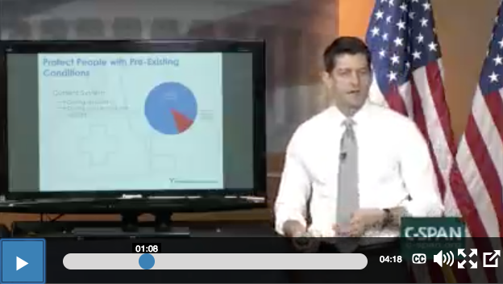
Or Witness Republican Speaker of the House Paul Ryan
Denouncing the idea of health insurance—needed since some people but not all get sick in an expense way:
One would think spreading risk and thus eliminating it via the law of large numbers would be a no-brainer, right?
No
Doug Elmendorf and Alice Rivlin assured me that Paul Ryan was good-hearted and… intelligent.
Paul Ryan:
“The fatal conceit of ObamaCare is that we are going to make everybody buy our idea of insurance, at the federal government level. Young and healthy people are going to go into the market and pay for older sicker people. So the young healthy person is going to be made to buy health care, and they are going to pay for the person who gets breast cancer in her forties, or gets heart disease in his fifties. So take a look at this chart. The red slice here are what I call people with pre-existing conditions. People with real health care problems. The blue is the rest of the people in the individual market, people who don’t get health insurance with their jobs, who buy it themselves. The whole idea of Obamacare is the people on the blue side pay for the people on the red side, that the people who are healthy pay for the people who are sick. It’s not working, and that’s why it’s in a death spiral…”
2:00
Notes:
Or witness former Republican Speaker of the House Paul Ryan, here denouncing the very idea of health insurance. Since some people but not all get sick in an expense way, one would think spreading risk and thus eliminating it via the law of large numbers would be a no-brainer, right? No. Not in Paul Ryan’s mind. Everyone should earn the money to pay for their own health care. And, in Paul Ryan’s mind, if you cannot afford to pay because your disease is expensive, then you should not get treated, and should die. For anything else is “people who are healthy paying for people who are sick”
My friends Doug Elmendorf and Alice Rivlin assured me that Paul Ryan was good-hearted and… intelligent. And I believe them.
Paul Ryan:
>The fatal conceit of ObamaCare is that we are going to make everybody buy our idea of insurance, at the federal government level. Young and healthy people are going to go into the market and pay for older sicker people. So the young healthy person is going to be made to buy health care, and they are going to pay for the person who gets breast cancer in her forties, or gets heart disease in his fifties. So take a look at this chart. The red slice here are what I call people with pre-existing conditions. People with real health care problems. The blue is the rest of the people in the individual market, people who don’t get health insurance with their jobs, who buy it themselves. The whole idea of Obamacare is the people on the blue side pay for the people on the red side, that the people who are healthy pay for the people who are sick. It’s not working, and that’s why it’s in a death spiral…
The “fatal conceit” is a call out to Friedrich von Hayek’s critique of the very idea that there can be a society that achieves “social justice”. But Friedrich von Hayek believed in health insurance, for he was at bottom an economist.

Slide 22
Social Democratic Political Stabilization Was Tenuous
1800s fears: “bread and circuses”—and tyranny and poverty:
People voting themselves benefits while they do not work
Analogies with Imperial Rome
Friedrich von Hayek’s Road to Serfdom
With which Keynes found himself in “deeply moved agreement”
Hayek was wrong
Pressures balanced
Positive-sum
2:15
Notes:
17.1.5. Social Democratic Political Stabilization
A standard nineteenth-century fear among the elites was that the possible arrival of universal suffrage would see the end of economic growth: redistributive and confiscatory taxation would destroy enterprise and provide “bread and circuses” to the working class—which would then succumb to the flattery of ruthless demagogues. Dire analogies with the coming of the Roman Empire were drawn. Friedrich von Hayek was only the most eloquent of those who feared that the coming to power of social democracy would in the end lead us down the Road to Serfdom to totalitarianism.
He was wrong. The social democratic regimes found in industrial economies in the second half of the twentieth century exhibited, up to 2016 at least, remarkable stability in democratic institutions, and remarkable success in preserving incentives for entrepreneurship, investment, and enterprise.
Opposing pressures balanced: populist calls for taking “unearned increment” from the rich balanced by an admiration for entrepreneurs and savers, and a realization that economic life is a positive sum game; compassion toward the poor balanced by resentment of those seen as trying to get something for nothing—even if the something was small by middle-class standards. From my perspective the balance point is too far to the right—we tolerate much more poverty than we should in the name of “incentives” and “entrepreneurship”. But it has not been too far: even on the right there was, for more than half a century after World War II, solid recognition that social democracy is politically necessary to maintain democratic support for the market economy.

Slide 23
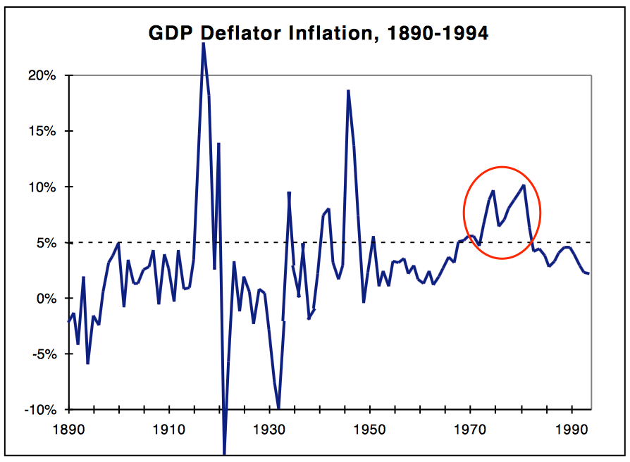
Still, Instability…
Only as long as growth is strong and economic stability is perceived is social democracy solid:
Paul Krugman’s theory:
Social Democracy rested on an ability to deliver the macroeconomic goods…
The inflation of the 1970s and the productivity slowdown destroyed the faith…
The pre-Depression right was there to pick up the pieces…
A historical contingency “butterfly’s wings” argument…
2:15
Notes:
But the political and economic balancing act of social democracy appears to have been possible only when strong economic growth continued, and as long as economic stability was perceived as certain.
And the record of the twentieth century is that modern mixed economies are not stable, and require the most delicate management to avoid economic chaos. Much of post-World War II discussion among economists has been consumed by sterile debate over whether the market economy is “naturally” “stable” or not. The answer is obvious: that if the government acts properly to reinforce the stabilizing factors and counteract the destabilizing ones, then the market economy is stable.
But what reason is there to think that governments are qualified to properly tune policy?
Thus social democracy’s successes during its high tide were vulnerable: they rested on a half-acknowledged foundation of rapid and uninterrupted economic growth.
Paul Krugman has a theory: that confidence in social semocracy rested on an ability to deliver the macroeconomic goods of full employment and stability. The inflation of the 1970s and the productivity slowdown destroyed that faith. The pre-Depression right was there to pick up the pieces. And as it picked up the pieces and brought “neoliberalism” with it, it set in motion the great rise in income and wealth inequality that has produced our Second Gilded Age.
This is a historical contingency “butterfly’s wings” argument: if only the 1970s had not seen the unmooring of expectations that inflation would be low, the shocks of the great oil price rises with the rise of OPEC, and the productivity slowdown. Then those opposed to further expansions of social democracy would not have gained political power. And we would not have seen the slower growth and rapidly rising inequality of the last forty years. And those tensions would not have had their further dire consequences for humanity’s ability to progress toward utopia.
Still, to have one’s strategy be that one could indefinitely via proper technocratic management stabilize an unstable economic system successfully—“live beyond your means on your wits”—is drawing to an inside straight, isn’t it? Isn’t a better, more robust strategy highly desirable?

Slide 24
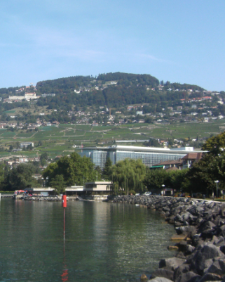
Laissez-Faire in Exile
Mont Pelerin!:
George Stigler—the Social Democratic state is corrupt and destructive
And enables insolence
Markets will take care of monopoly
And of discrimination
Milton Friedman: the Great Depression was really the government’s fault
The Federal Reserve needed to keep a stable money supply
That is the “neutral” “laissez faire” monetary policy
The Federal Reserve failed to do so
And so caused the Great Depression
Charles Murray here
Damage done by the culture of dependency…
“New class”
3:30
Notes:
During the Thirty Glorious Years, the left wing challenge to social democracy was made flesh, and dwelt among us—or at least dwelled on the other side of the Iron Curtain. It was there, visible, as really existing socialism. It was most unattractive.
Thus when social democracy began to be perceived as failing to deliver the goods, there were no credible proposals for further left-wing reform that could be picked up and put into action.
On the other hand, the right wing challenge—that the step away from laissez-faire had been a mistake—no longer existed anywhere on the globe. Thus its flaws were not on exhibition in the real world. Thus a small faithful remnant could gather on Mont Pelerin, where the old men could dream dreams and the young men see visions.
On the microeconomic level it was George Stigler who led the intellectual critique of social democracy. The social democratic state is corrupt and destructive. Simple reliance on markets will produce a relatively egalitarian distribution of income. Markets will take care of monopoly, except for those monopolies maintained by the government. Markets will take care of discrimination, except for discrimination maintained by the government. To rely on the social democratic state to equalize income and to eliminate discrimination will encourage the growth of classes of moochers who will never work for themselves. They will learn the wrong lesson that they can get the good things of life without contributing to society via using their power at the ballot box. Witness, George Stigler wrote, the Negro civil rights demonstrations of the 1960s, “growing in size and insolence”.
That word, “insolence”, is a definite tail.
On the macroeconomic side, Milton Friedman argued that people had drawn the wrong conclusions from the Great Depression.
The Great Depression showed not that the market economy was unstable and needed Keynesian social democratic management. It showed, rather, that government was so inept that it could destabilize a market economy that was actually highly stable. Government bad action could produce a Great Depression out of nothing at all, totally unnecessarily. All the government had had to do was maintain a stable growth of the money supply, and there would have been no Great Depression.
Of course, during the great recession that started in 2009, Federal Reserve Chairman Ben Bernanke had done more than maintain a stable growth rate of the money supply: he had greatly boosted the growth rate of the money supply. According to Milton Friedman's theories, those policy moves should have not just avoided depression but produced substantial inflation at full employment. They did not.
Friedman was wrong
But back in the day, because Milton Friedman’s policies had not been tried, it could be claimed that it was obvious that they would have been highly successful if they have been tried. Thus the Great Depression was the government’s fault.
Add to Stigler and Friedman. add Friedrich von Hayek's critique: social democracy as eroding the moral fiber of the people and leading to growth of an evermighty state that would inevitably threaten liberty.
The laissez-faire right was poised to make a half return at whatever moment social democracy would run into trouble.

Slide 25
Failures of Social Democracy
The “commanding heights”:
Britain’s Attlee government of the 1940s…
Nationalize!
Not just infrastructure and health
Nationalize market economy corporations
A bet on economies of scale?
Why the belief in government production?
Three factors:
Fear of monopoly
Fear that monopolists would own the government
Echoes of classical Marxism
6:00
Notes:
16.2. Failures of Social Democracy
16.2.1. The Commanding Heights
In the age of social democracy, all over the industrialized and developing parts of the world, governments—even the most anti-Communist of governments—somehow got it into their heads that they should run and operate businesses. Public control and operation of the “commanding heights” of the economy was seen as a proper goal.
Consider the case of Britain’s Attlee government. In the late 1940s the Attlee government nationalized the Bank of England, the railways that became British Rail, airlines, telephones, coal mining, electric power generation, long-distance trucking, iron and steel, and natural gas provision. Officially, management policy did not change once industries were nationalized: commercial profitability remained the official objective (although pursued with less vigor, especially as far as possible plant closings were concerned). Coal workers and railroad workers hoped that the public sector would be more benevolent and higher-wage employer than the private sector. They were apparently mistaken.
Donald Sassoon quotes from official histories that:
>Very little thought had been given to the organization of the nationalized industries either in the Labour movement or in Whitehall”
and asks the natural question:
>Why was there such a wide extension of public control if Labour did not know what to do with it?
He answers his question by pointing to:
>The traditional left-wing bias against private ownership…. The extension of state ownership was good in itself, because it brought the ‘end-state’ of socialism that much nearer.”
In retrospect this is puzzling: the social-democratic insistence on government provision of goods and services—not government demand, not government distribution, not government price and quality regulation, but government production. All over the world the belief that large chunks of productive industry ought to be publicly-owned and managed dominated the mid-twentieth century. There are still immense state-owned and state-managed enterprises: railroads, hospitals, schools, power generating facilities, steel works, chemical factories, coal mines, and others.
This is puzzling because governments’ core competence has never been in running a hospital, or a steel mill, or a railroad. Such organizations ought to be run with an eye on efficiency: getting the most produced with the resources available. But governments’ logic of operation is very different: it is a logic of the political adjustment of conflicting interests. As a result, government-managed enterprises—whether the coal mines of Britain or the telecommunications monopolies of western Europe or the oil-production monopolies of developing nations—are likely to be inefficient and wasteful.
For a social-democratic political movement to choose government ownership and management of industry as the hill to die on is rarely good policy, and is unlikely to be good durable politics. And indeed it was not. When Margaret Thatcher’s conservatives took office in the late 1970s, it was behind the slogan of “Britain isn’t working”—which meant both that unemployment was high, and that state-owned enterprises were inefficient, provided poor service, and had payrolls amply padded for political reasons
Now there are times and places when you do not want “efficiency”—at least not in the sense of maximizing the total amount of measured output given the available resources. There are times when you want “soft” rather than “hard” incentives: a health clinic that is paid by insurance companies should not be replacing antibiotic solutions with colored water in order to decrease its costs. A company running an electricity distribution network should not skimp on maintenance of the system as a whole in order to boost its current profits.
But the cases in which “soft” incentives are desirable are not that many. Ultimate consumers must be poor judges of quality, or must be unable to vote-with-their-feet by switching to alternative suppliers, or there must be no alternative suppliers to switch to before one reaches the stage where one would rather rely solely on the professionalism and the pride of accomplishment and usefulness of the producers. Elsewhere, the hard material incentives for efficient performance provided to the for-profit enterprise in market context are very valuable. And quality (and price!) regulation is often a much more attractive alternative than is public ownership and management of the enterprise.
As best as I can judge, the sources of demand for public ownership of the “commanding heights” of the economy had three sources:
• First, an inordinate fear of monopoly: a belief that economies of scale would ultimately lead to the domination of one single firm in most industries, and that that one single firm would exploit the public unmercifully if it were not state-owned.
• Second, a fear that the monopoly bosses would own the government: that regulation would be ineffective because the monopoly bosses would simply buy off the regulators, and that only public ownership that destroyed the monopoly bosses could avoid this problem.
• Third, the echoes of the classical Marxist belief that the market was inherently corrupted by exploitation—and that such exploitation could be avoided by eliminating the private ownership of the means of production.
All of these sources seem naïve to us now. If the market is inherently corrupted by exploitation, what do we think of bureaucratic hierarchies? Yes, monopoly is to be feared. Yes, there are grave problems in a world in which much economic life is increasing-returns-to-scale of controlling monopoly. But a publicly-managed monopoly is a monopoly still.
But, in terms of its effect on its political support, inefficiency in operating the “commanding heights” was small beer compared to the failure of social democracy to deliver a semi-stable price level.

Slide 26
Sparking the Inflation of the 1970s
The strange salience of 1970s inflation:
A stable Phillips curve?
Richard Nixon’s dilemma
The “Nixon shocks”
Jacob Viner’s snark
“In a world organized in accordance with Keynes’ speciﬁcations, there would be a constant race between the printing press and the business agents of the trade unions, with the problem of unemployment largely solved if the printing press could maintain a constant lead…”
And he gloomily called the General Theory a “book which is likely to have more influence than it deserves…”
4:30
Notes:
16.2.2. Sparking the Inflation of the 1970s
16.2.2.1. Raising the Anchor of the Price Level
The inflation of the 1970s was not a big deal—much slower in pace than wartime inflations, much less damaging to senses of fairness and to the distribution of incomes than hyperinflations. Yet it became strangely salient. And the existence of a decade in which the average annual inflation rate was above 5% led to very harsh judgments as to the effectiveness and worthiness of social democracy.
Let me back up.
Time passed after World War II, and the memory of the Great Depression dimmed. Between 1954 and 1969—between the Korean War and the height of the Vietnam War—it looked as though the U.S. economy was sliding back and forth along a stable inﬂation-unemployment “Phillips Curve.” Democratic-Party governments tended to spend more time at the left end of the curve, with relatively low unemployment. Republican governments tended to spend more time at the right end, with relatively low inﬂation and higher unemployment.
But by absolute and by historical standards, both inﬂation and unemployment were low. The ﬁrst sign that something had changed came during Richard Nixon’s ﬁrst term as president. He attempted to move the economy from the left to the right side of the 1954-69 curve, and found that it would not go. 1970-1973 saw unemployment and inﬂation both at high levels relative to the previous post-World War II experience (although still at low levels absolutely).
After some thought, a consensus was reached: tight monetary policy and attempts to ﬁght inﬂation by marginally increasing unemployment no longer worked because no one believed that such efforts would be continued very far. Auto workers, say, believed that the government would not allow widespread unemployment in the automobile industry—that the government would pump up nominal demand to give people enough liquidity to buy cars if ever the industry’s sales began to drop. This left the United Auto Workers, therefore, with no incentive to moderate its wage demands-it was not risking serious unemployment on the part of its members if it did so. And this left the automobile manufacturers with no incentive to resist demands for higher wages: they could simply pass them on in higher prices. And so the economy had grown “used to” steady inﬂation at ﬁve percent per year. How to deal with this dilemma? One possibility was that the government should create a truly massive recession: should make it painfully obvious that if inﬂation rose too high and if wages agreed on by workers and ﬁrms rose too rapidly, the government would not accommodate, would not expand nominal demand, but would instead inﬂict unemployment and keep unemployment high until inﬂation came down. No president wanted to think about this possibility. It was, in the end, the road the United States took, but largely by accident and after many stopgaps. And taking this road led to the end of the most successful economic order the industrial world had seen. Back in the 1930s, Chicago-school economist Jacob Viner had reviewed Keynes’s General Theory. He had snarked that:
>In a world organized in accordance with Keynes’ speciﬁcations, there would be a constant race between the printing press and the business agents of the trade unions, with the problem of unemployment largely solved if the printing press could maintain a constant lead...
And he gloomily called the General Theory a “book which is likely to have more influence than it deserves.”

Slide 27
Sparking the Inflation of the 1970s
The strange salience of 1970s inflation:
A stable Phillips curve?
Richard Nixon’s dilemma
The “Nixon shocks”
Jacob Viner’s snark
“In a world organized in accordance with Keynes’ speciﬁcations, there would be a constant race between the printing press and the business agents of the trade unions, with the problem of unemployment largely solved if the printing press could maintain a constant lead…”
And he gloomily called the General Theory a “book which is likely to have more influence than it deserves…”
4:30
Notes:
16.2.2. Sparking the Inflation of the 1970s
16.2.2.1. Raising the Anchor of the Price Level
The inflation of the 1970s was not a big deal—much slower in pace than wartime inflations, much less damaging to senses of fairness and to the distribution of incomes than hyperinflations. Yet it became strangely salient. And the existence of a decade in which the average annual inflation rate was above 5% led to very harsh judgments as to the effectiveness and worthiness of social democracy.
Let me back up.
Time passed after World War II, and the memory of the Great Depression dimmed. Between 1954 and 1969—between the Korean War and the height of the Vietnam War—it looked as though the U.S. economy was sliding back and forth along a stable inﬂation-unemployment “Phillips Curve.” Democratic-Party governments tended to spend more time at the left end of the curve, with relatively low unemployment. Republican governments tended to spend more time at the right end, with relatively low inﬂation and higher unemployment.
But by absolute and by historical standards, both inﬂation and unemployment were low. The ﬁrst sign that something had changed came during Richard Nixon’s ﬁrst term as president. He attempted to move the economy from the left to the right side of the 1954-69 curve, and found that it would not go. 1970-1973 saw unemployment and inﬂation both at high levels relative to the previous post-World War II experience (although still at low levels absolutely).
After some thought, a consensus was reached: tight monetary policy and attempts to ﬁght inﬂation by marginally increasing unemployment no longer worked because no one believed that such efforts would be continued very far. Auto workers, say, believed that the government would not allow widespread unemployment in the automobile industry—that the government would pump up nominal demand to give people enough liquidity to buy cars if ever the industry’s sales began to drop. This left the United Auto Workers, therefore, with no incentive to moderate its wage demands-it was not risking serious unemployment on the part of its members if it did so. And this left the automobile manufacturers with no incentive to resist demands for higher wages: they could simply pass them on in higher prices. And so the economy had grown “used to” steady inﬂation at ﬁve percent per year. How to deal with this dilemma? One possibility was that the government should create a truly massive recession: should make it painfully obvious that if inﬂation rose too high and if wages agreed on by workers and ﬁrms rose too rapidly, the government would not accommodate, would not expand nominal demand, but would instead inﬂict unemployment and keep unemployment high until inﬂation came down. No president wanted to think about this possibility. It was, in the end, the road the United States took, but largely by accident and after many stopgaps. And taking this road led to the end of the most successful economic order the industrial world had seen. Back in the 1930s, Chicago-school economist Jacob Viner had reviewed Keynes’s General Theory. He had snarked that:
>In a world organized in accordance with Keynes’ speciﬁcations, there would be a constant race between the printing press and the business agents of the trade unions, with the problem of unemployment largely solved if the printing press could maintain a constant lead...
And he gloomily called the General Theory a “book which is likely to have more influence than it deserves.”

Slide 28
Lenin Has Said…
The strange salience of 1970s inflation II:
Largely zero-sum
An increase in risk, but little more
Yet the economists were wrong.
Keynes in the early 1920s:
“Lenin is said to have declared that the best way to destroy the capitalist system was to debauch the currency. By a continuing process of inflation, governments can confiscate, secretly and unobserved, an important part of the wealth of their citizens. By this method they not only confiscate, but they confiscate arbitrarily; and, while the process impoverishes many, it actually enriches some. The sight of this arbitrary rearrangement of riches strikes not only at security but [also] at confidence in the equity of the existing distribution of wealth. Those to whom the system brings windfalls, beyond their deserts and even beyond their expectations or desires, become "profiteers," who are the object of the hatred of the bourgeoisie, whom the inflationism has impoverished, not less than of the proletariat. As the inflation proceeds and the real value of the currency fluctuates wildly from month to month, all permanent relations between debtors and creditors, which form the ultimate foundation of capitalism, become so utterly disordered as to be almost meaningless; and the process of wealth-getting degenerates into a gamble and a lottery.
“Lenin was certainly right. There is no subtler, no surer means of overturning the existing basis of society than to debauch the currency. The process engages all the hidden forces of economic law on the side of destruction, and does it in a manner which not one man in a million is able to diagnose…”
A government that generates such inflation—even the moderate inflation of the 1970s—is obviously not competent
It needs to be replaced—and a new policy course needs to be charted
3:45
Notes:
16.2.6. Why Did It Matter for the Stability of Social Democracy?
From an economist’s perspective, an inflationary episode like that of the United States in the 1970s—in which inflation bounces around between 5% per year and 10% per year for a decade—cannot, does not, will not matter (much). Prices go up. But wages and profits go up as well. Perhaps there are some somewhat-damaging economic distortions introduced by the tax treatment of nominal interest payments, and by the failure to rebase basis values for the purposes of capital gains taxes. Certainly those who have borrowed in fixed sums of nominal dollars or at fixed nominal interest rates win. Certainly those who have loaned in fixed sums of nominal dollars or at fixed interest rates lose. But there is already an awful lot of luck and chance in incomes and payments. Inflation is a zero-sum redistribution. Some lose, but others gain as much. With no strong reason to think that the losers are in any sense more deserving than the gainers, why care (much)? Why should anyone care (much)?
This is wrong. Return to John Maynard Keynes’s assessment of the consequences of inflation during and after World War I:
>Lenin is said to have declared that the best way to destroy the capitalist system was to debauch the currency. By a continuing process of inflation, governments can confiscate, secretly and unobserved, an important part of the wealth of their citizens. By this method they not only confiscate, but they confiscate arbitrarily; and, while the process impoverishes many, it actually enriches some. The sight of this arbitrary rearrangement of riches strikes not only at security but [also] at confidence in the equity of the existing distribution of wealth. Those to whom the system brings windfalls, beyond their deserts and even beyond their expectations or desires, become "profiteers," who are the object of the hatred of the bourgeoisie, whom the inflationism has impoverished, not less than of the proletariat. As the inflation proceeds and the real value of the currency fluctuates wildly from month to month, all permanent relations between debtors and creditors, which form the ultimate foundation of capitalism, become so utterly disordered as to be almost meaningless; and the process of wealth-getting degenerates into a gamble and a lottery.
Lenin was certainly right. There is no subtler, no surer means of overturning the existing basis of society than to debauch the currency. The process engages all the hidden forces of economic law on the side of destruction, and does it in a manner which not one man in a million is able to diagnose…
Keynes was speaking of high inflation: enough to take “all permanent relations between debtors and creditors, which form the ultimate foundation of capitalism” and make them “utterly disordered”.
That inflicts real harm on the division of labor and the functioning of the economy.
But woven through this passage is another effect: One can usually pretend that there is a logic to the distribution of wealth—that somebody’s hard work and skill lies behind prosperity, either the possessor of wealth’s hard work and skill, or that of some ancestor, or that of those that the possessor was far-sighted enough to hire. Inflation—even moderate inflation—strips the mask. It is then, obviously, “windfalls” to “profiteers”, the result of a “degenerate[d]… gamble and a lottery”.
And a government that generates such an inflation is, obviously, not competent at what it is doing. Thus in the late 1970s all critics of social democracy had to do was to point at the inflation, and say: Would a well-functioning political-economic system have produced this? We need to think again, and reform. We need to make what became the neoliberal turn.

Slide 29
Review: Broad Sweep
What was the growth rate of ideas in the industrial core of the world economy over 1870-2020?
About 2.3%/year
About 0.9%/year
About 0.23%/year
About 4%/year
None of the above

Slide 30
Review: Broad Sweep
What was the growth rate of ideas in the industrial core of the world economy over 1770-1870?
About 2.1%/year
About 0.45%/year
About 0.15%/year
About 0.04%/year
None of the above

Slide 31
Takeaways from This Time
Social Democracy: High Tide and Ebb
Give me five takeaways…

Slide 32
Notes: What Was Unconvincing Today?
Mistakes and unclarities: typos, wordos, and mindos…
In the DRAFT textbook?
In the lecture?

Slide 33
Catch Our Breath…
Ask a couple of questions?
Make a couple of comments?
Any more readings to recommend?

